Slide 1
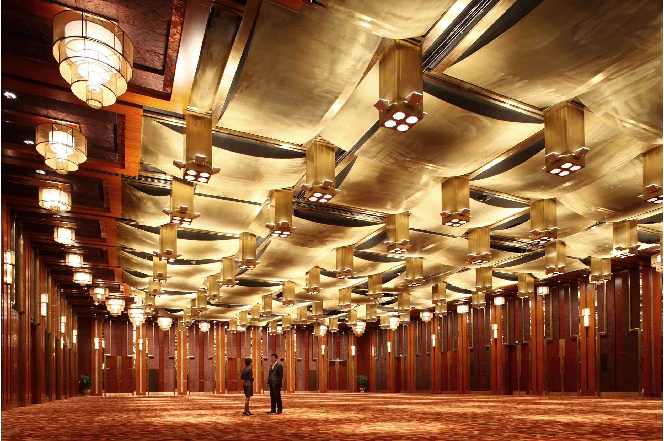
MoVIS A Movement and Proximity Visualization Tool Specially Designed for Conference Organizers
Group 6: Heber Ng, Li Jing, Xie Weiyi

Slide 2
Content
1
Background & Motivation
Objectives
Tools & Packages
Design Framework
App Demo using Use Case
Challenges & Lessons Learnt
2
3
4
5
6

Slide 3
Background & Motivation
Emergence of Internet of Things (IoT)
Increasing trend in adoption of wearable devices, such as smart badges in monitoring and improving security measures and crowd control procedures in events.
Opportunities:
Lack of ability in facilitating conference organizers in deriving useful insights, such as event performance and security loopholes.
Type of information flow: Push vs Pull vs Interactive

Slide 4
Objectives
To develop an interactive web application using R Shiny for conference organizers to:
Visualize attendees’ movements in the event space
Draw insights on crowd densities as well as connectivity of different event locations
Advantages:
Usability – allows users to interactively explore the data
Accessibility – easy access through web
Flexibility – can be applied to any dataset of a certain format

Slide 5
Tools and Packages
R Shiny
Schema
Design Rationale
Modular approach
Parallel development
Easy to debug
Future extensibility

Slide 6





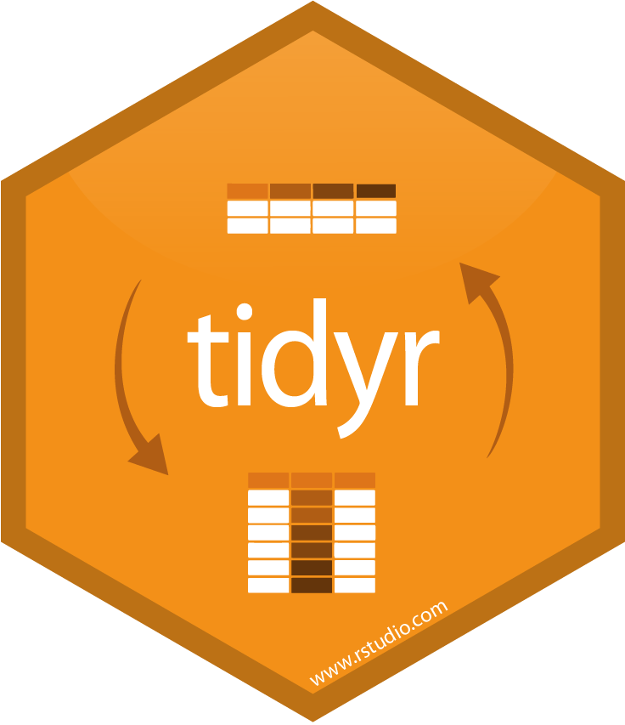

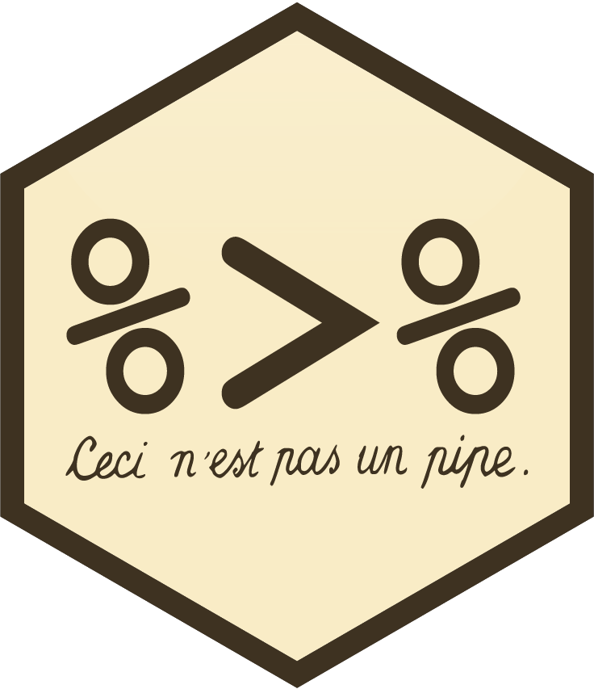
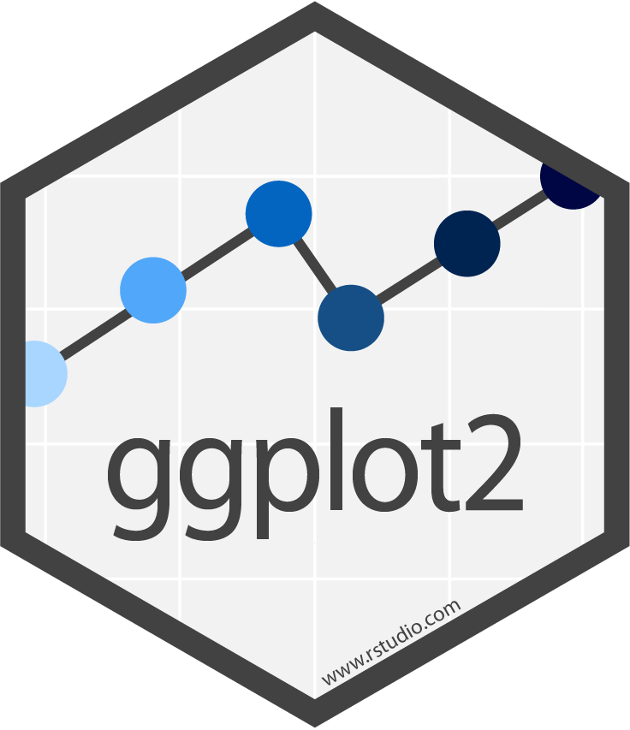

Tools and Packages
Function | Packages
Web Application | shiny, shinyTree, shinydashboard, shinyjs
Data Preparation | tidyverse, lubridate, sqldf
Crowd Analysis | plotly, choropleth, ggridges, ggplot2
Network Analysis | igraph, tidygraph, networkD3, visNetwork, chorddiag, sunburstR

Slide 7
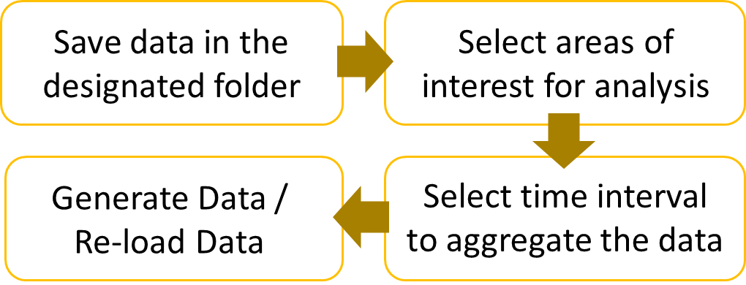
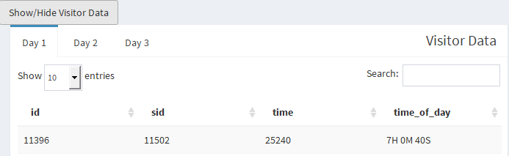
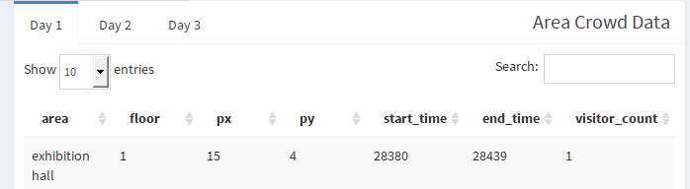
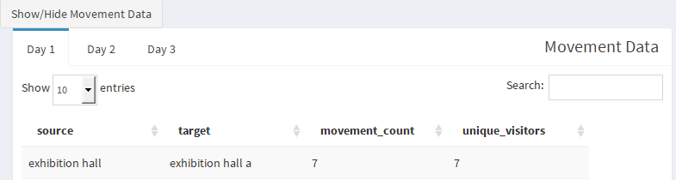
Design Framework
Data Preparation
Crowd Analysis
Network Analysis
To prepare and transform data into desired format for subsequent analysis
1. Data Preparation & Transformation
2. Data Preview
Visitor Data
Area Crowd Data
Movement Data

Slide 8
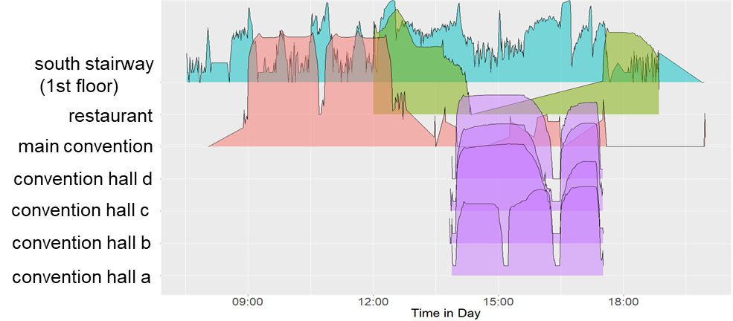
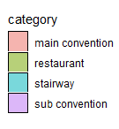
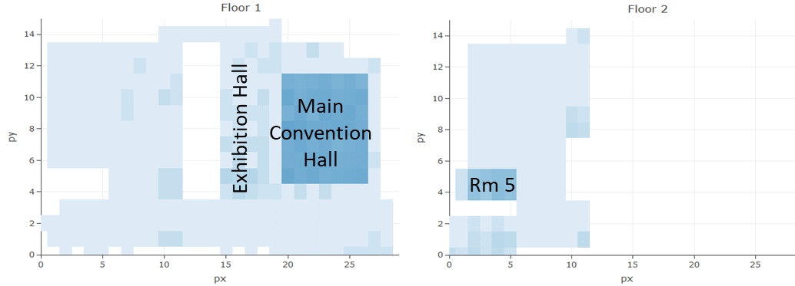
Design Framework
Data Preparation
Crowd Analysis
Network Analysis
To visualize crowd densities and changes in crowd distributions in the event space over time
1. Floor Choropleth Map
2. Ridgeline Plot
To visualize crowd densities across event space
To visualize changes in crowd distributions over time and event space.

Slide 9
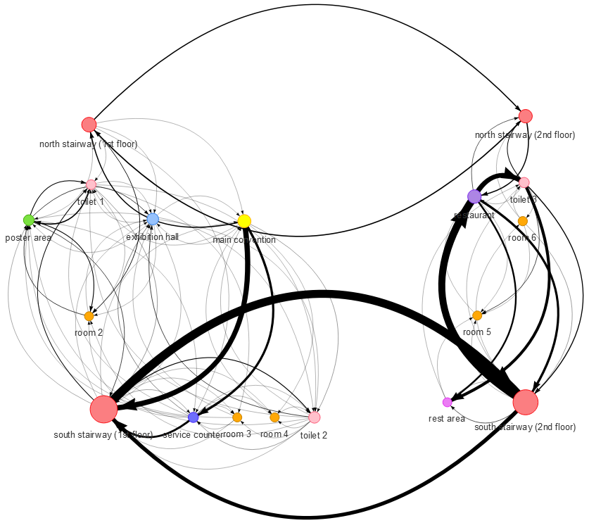
Design Framework
Data Preparation
Crowd Analysis
Network Analysis
To visualize crowd flow from area to area and relationship between functional areas
1. Directed Weighted Network Diagram
To visualize interconnections of different functional areas
Centrality Measures – importance of each location
In-degree | sum of weights of all in-coming edges
Out-degree | sum of weights of all out-going edges
Betweenness | number of shortest paths going through a node
Closeness | how many steps required to access every other node from a given node

Slide 10
Design Framework
Data Preparation
Crowd Analysis
Network Analysis
To visualize crowd flow from area to area and relationship between functional areas
2. Chord Diagram
3. Sunburst Diagram
To visualize interrelationships of locations
To visualize paths of conference attendees

Slide 11
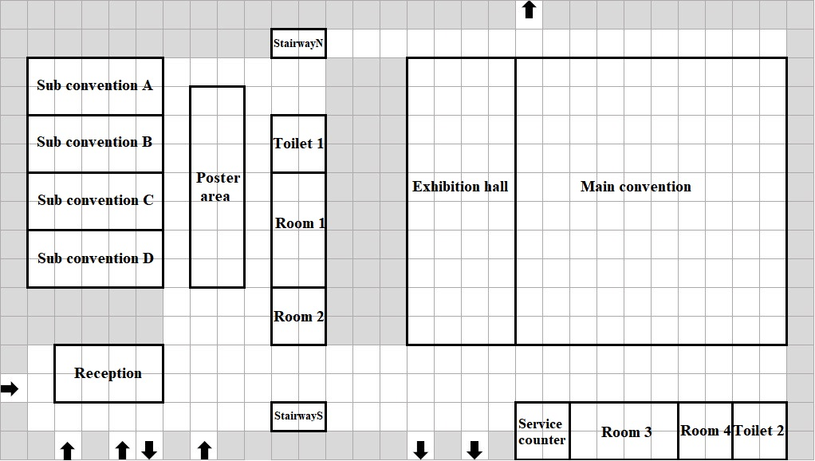
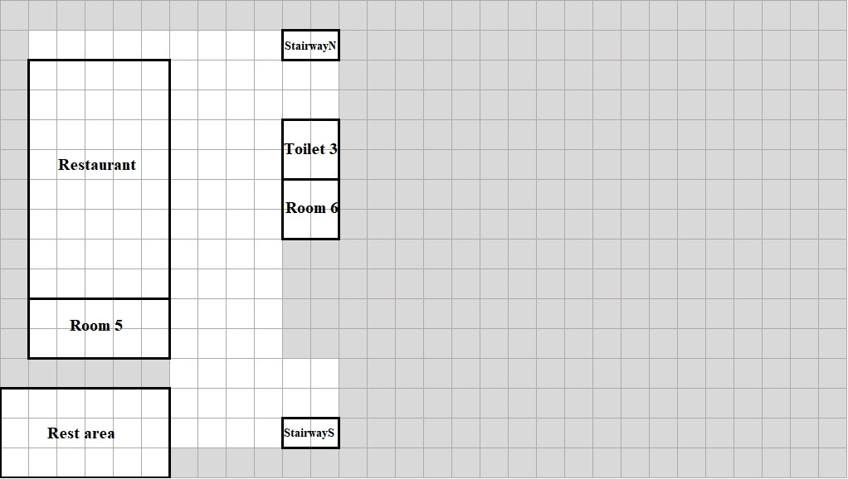
Overview of Use Case
Datasets: ChinaVis 2019 Mini Challenge 1
Sensor Location: sensor id, floor, x & y coordinates
Sensor Log: sensor id, attendee id, timestamp
CICSC Conference
3-day event
~ 5000 attendees
Event space consists of 2 floors
Event space covered by a network of sensors located in an interval of 8 meters

Slide 12
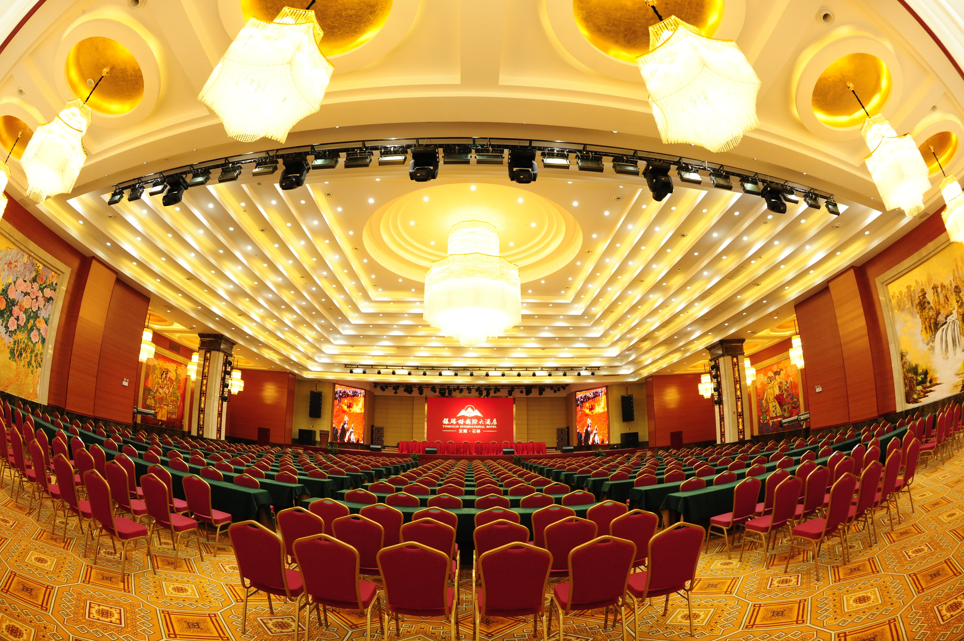
APP Demo - MoVIS

Slide 13
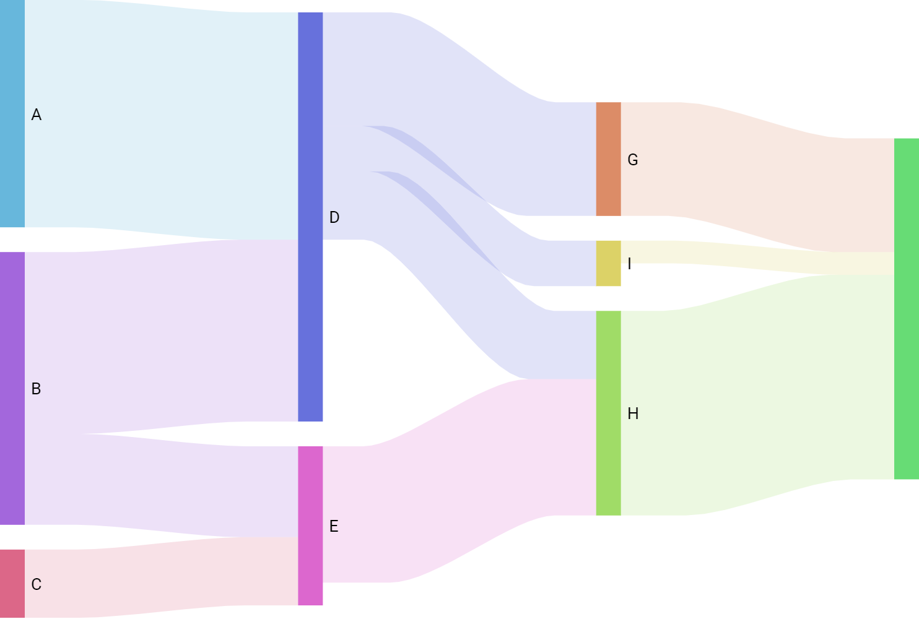
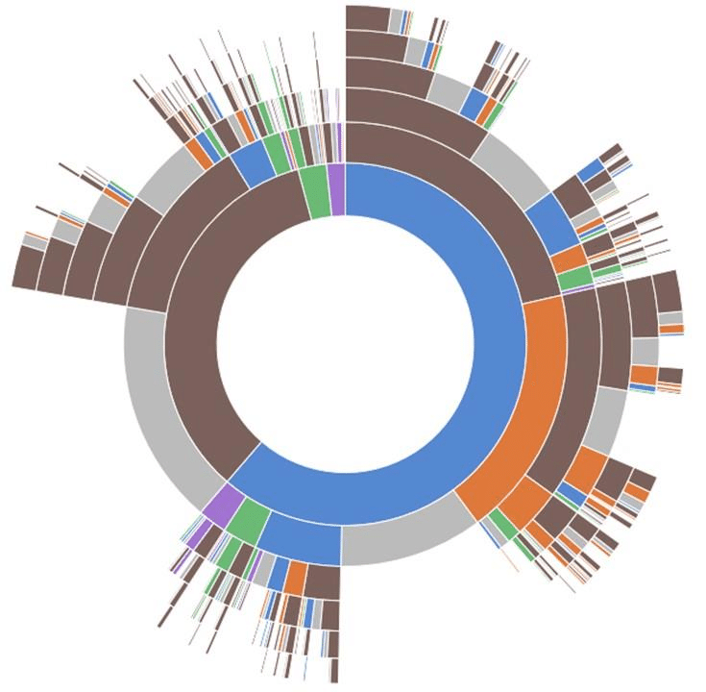
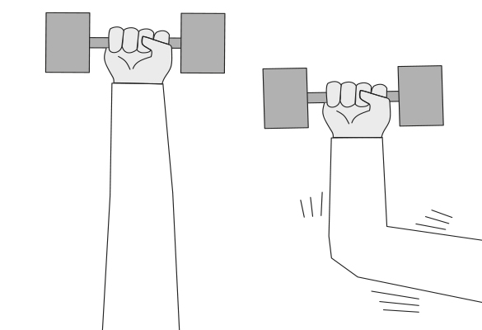
Challenges & Lessons Learnt
Choice of visualization tools
Sankey vs Sunburst Diagram
Slow data processing
Due to merging and aggregating of multiple large data frames
Optimized through introducing data preparation steps and storing as static data frames
Notes:
Due to the large number of observations in certain datasets, manipulating the data to fit into specific dimensions to be used in visualizations often takes a long time. This is particularly true when the data needed require merging and aggregating of multiple large dataframes

Slide 14

Q&A

